Slide 1
Reservoir road surgery ppg meeting
06/07/2021
CHAIR: H K
GP LEAD: Dr G W Durston

Slide 2
Changes since covid-19

Slide 3
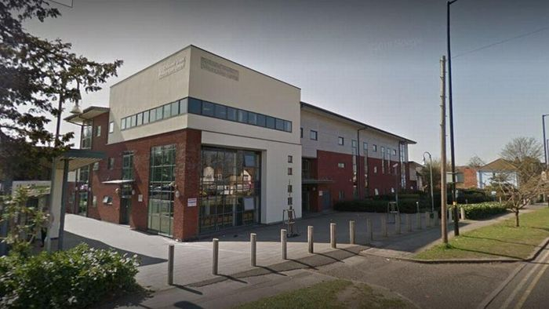
accessibility
We closed our doors for everyone’s safety

Slide 4
…but we still allow patients to come to the surgery anytime between
2.45pm – 3.45pm
During this time patients can come to the ‘window’ and collect forms, complete registration and more!

Slide 5

Doctor accessibility
Some patients are allowed to come into the surgery for a face to face appointment but that is only after they have had a telephone appointment with the doctor.
Request for home visits has remained the same even after the pandemic.
Nurse appointments have not changed although aerosol investigations are still on hold due to government guidelines.
Next month a new website (footfall) will be introduced – easier access to local NHS services and access to GPs

Slide 6


appointments
Telephone triage offered which can lead to an in person appointment
accuRx introduced – can now text message patients, video consultations and receive images from patients

Slide 7
DOCTORS
In the next 6 months 3 new GPs will be employed, leaving us with an increased number of GPs available for appointments…
PARTNERS: SALARY GPs: LOCUMS:
Dr Durston (m) Dr Siddiqui (f) used as and when they’re needed
Dr Maimoon (m) Dr Heatman (f)
Dr Khan (m) Dr Jeyagopal (m)
Dr Imrani (m)
Dr Saeed (f)
Dr Popat (f)

Slide 8

phones
Increased the call queue from 10 to 15 patients at a time
20 minute waiting time before the call gets cut off (at the request of patients)
Double the usual number of people answer phones at peak times

Slide 9
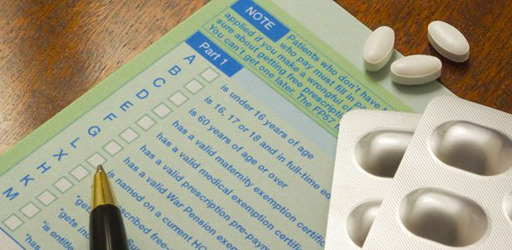
prescriptions
More options!
  Online – completed using the website, app …
  Leaving them in a secure envelope in the post box outside
  Can go straight to your chosen pharmacy electronically (around 99% are done electronically now)

Slide 10
Vaccination programmes
Successful covid vaccination programme with an excellent uptake across the board
Due to vaccine storage patients had to be directed to Poplar’s surgery (as per government directions)
Flu vaccines have been ordered for this year
Awaiting full update on 3rd covid vaccine booster
Children immunisations all up to date
Nursing and residential homes and housebound patients have been vaccinated by the practice GPs

Slide 11
Thank you for listening. Feel free to ask any questions.

